Slide 1
CYBERCAFE

Slide 2

Definition
An internet café or cybercafé is a place which provides internet access to the public, usually for a fee. These businesses usually provide snacks and drinks, hence the café in the name. The fee for using a computer is usually charged as a time-based rate.

Slide 3

Customers
A Cybercafe only for students.

Slide 4
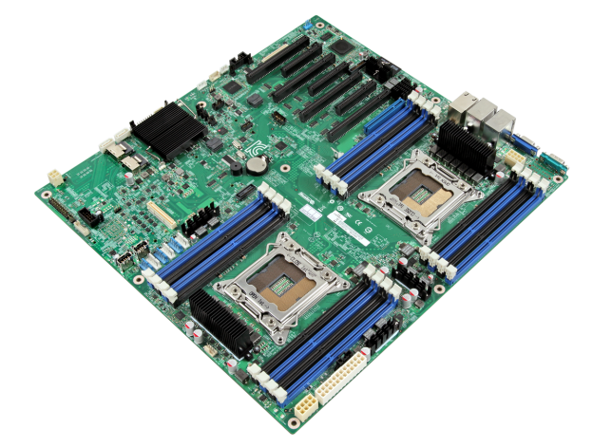
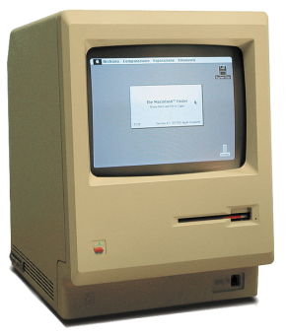

Decor
The walls are decorated with a variety of technical subjects, old computer parts, and photos.
Customers will be able to relax and spend your free time in a comfortable chair, called Pufiki

Slide 5
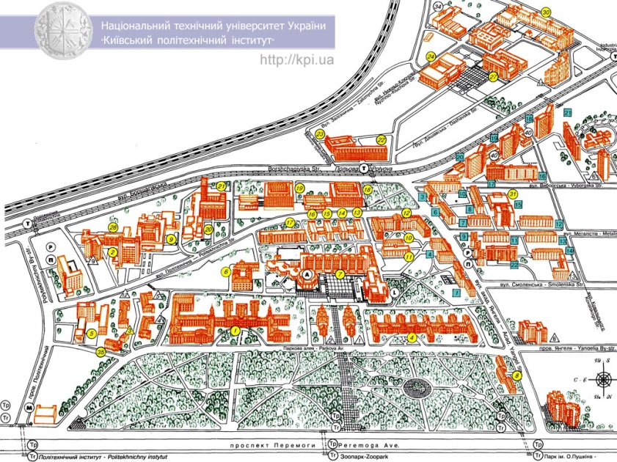

Location
Café will be located near the university. Students can visit it before or after their studies.

Slide 6
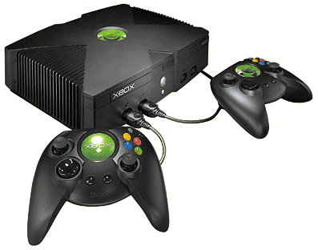
Services
eat
play games
read a book or newspaper
have a drink
listen to music
surfing the Internet
fun and relax with friends in a pleasant atmosphere

Slide 7
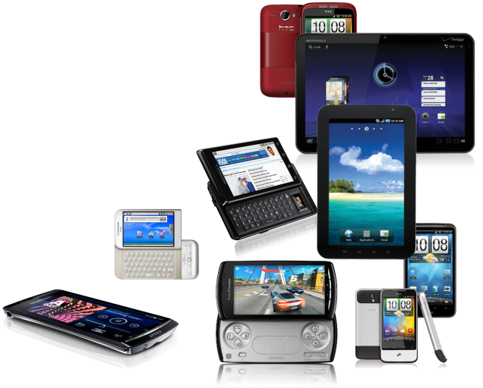
Devices
personal computers
tablets
game consoles
other devices

Slide 8


CYBERCAFE HOUSE

